Slide 1
Property Binding

Slide 2
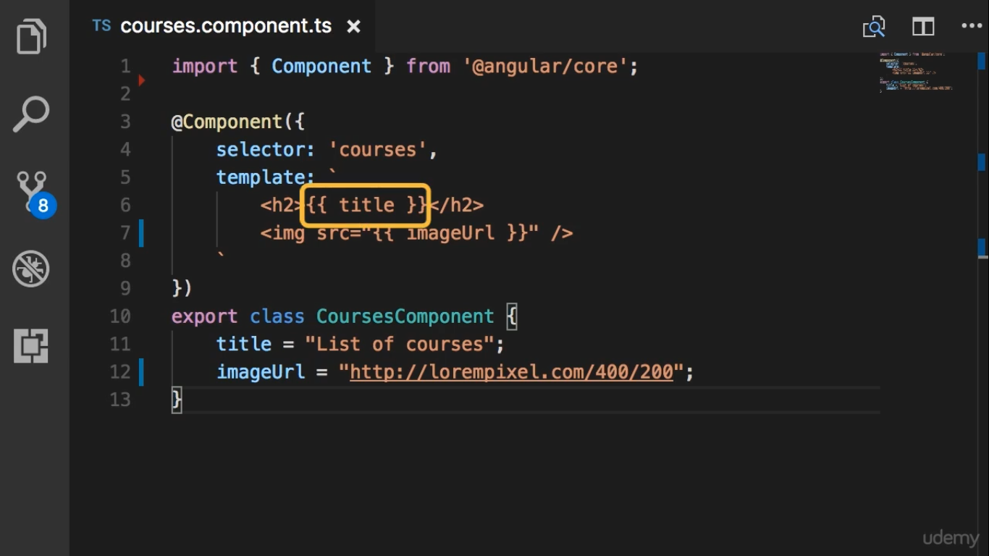

Slide 3


Slide 4
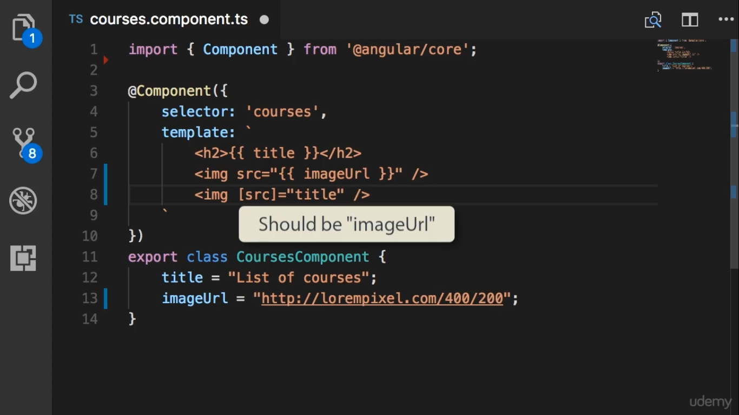

Slide 5
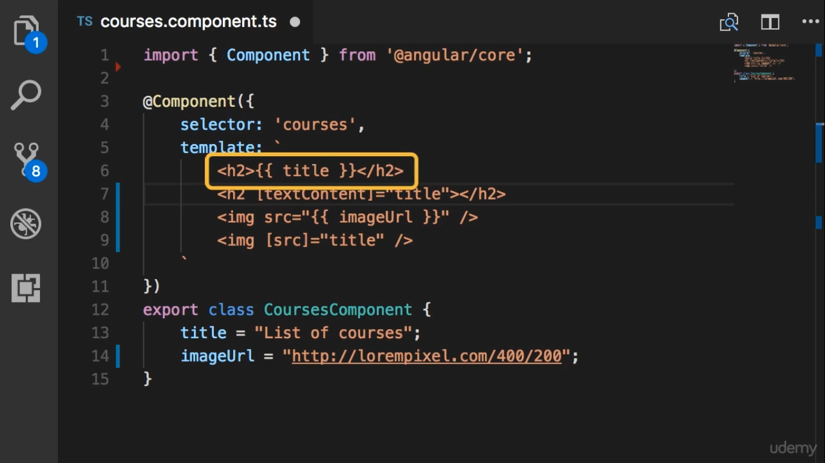
Should use String Interpolation syntax

Slide 6
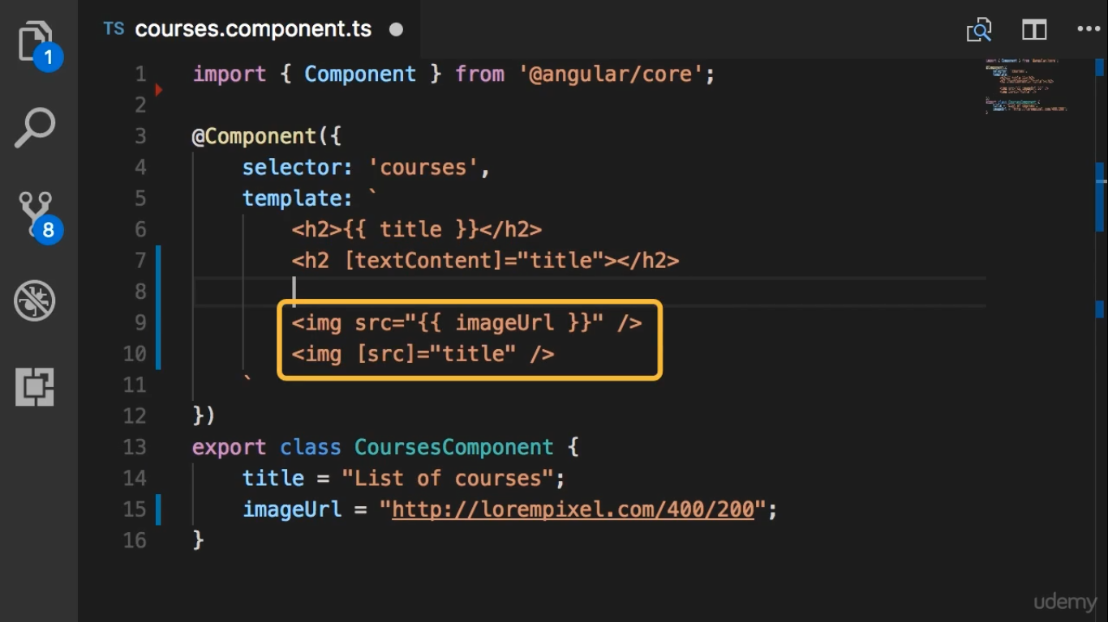
Should use Property Binding syntax
One Way Binding
From Component to the Dom

